Slide 1


STEM
Notes:
Today we will be completing the BRONZE crest award

Slide 2

CREST AWARDS
WHAT IS A CREST AWARD?
Designed to get teens like you to think like scientists and engineers
CREST is a Nationally recognised award great for College, University and Job applications
CREST is the best way to include STEM to your parade nights

Slide 3

CREST AWARDS
LEVELS OF AWARD
DISCOVERY
5 HOURS
£3
BRONZE
10 HOURS
£5
SILVER
30 HOURS
£10
GOLD
70 HOURS
£20

Slide 4
CREST AWARDS
LEVELS OF AWARD
BRONZE
10 HOURS
£5
5 PARADE NIGHTS
OR
1 FULL WEEKEND
MORE COMPLEX PROJECT
BEST FOR 14-16 YEAR OLDS

Slide 5
CREST AWARDS
EXAMPLE BRONZE AWARD (INVESTIGATION)
WIND TUNNEL PROJECT
Award Level: Bronze Award
Project: How lift is affected by wing shape
Research: Research how lift is generated, Principles of Flight, different wing cross-sections
Experiment: Make a simple wind tunnel with a hair dryer and test wing shapes.
Consolidation: Present research and experimental findings and complete the Bronze Workbook (1 per team)

Slide 6

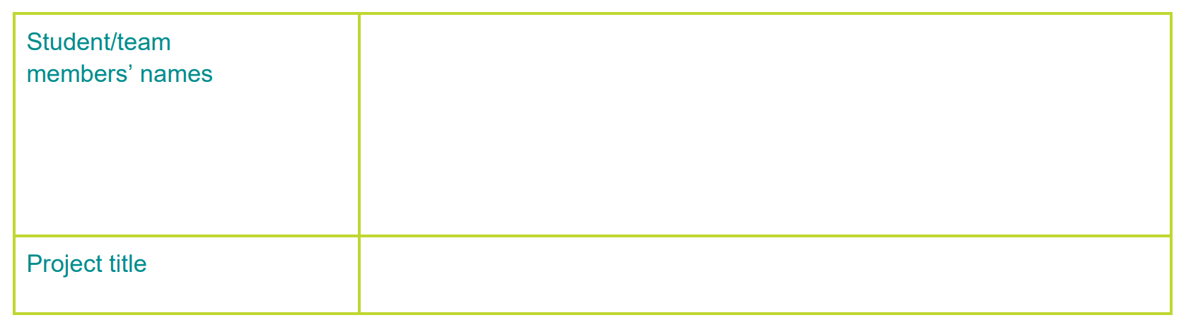




CREST AWARDS
BRONZE PASS CRITERIA
PLANNING
PROJECT
CONSOLIDATION
PROJECT-WIDE
1.1 Clear Project Aim
2.1 Good Use of Resources
3.1 Project Conclusions
4.1 Scientific Understanding
1.2 Project Purpose
2.2 Research and Referencing
3.2 Personal Contribution
4.2 Safety Considerations
1.3 Multiple Approaches
3.3 Project Reflection
4.3 Creative Thinking
1.4 Had a Project Plan
4.4 Problem Solving
1.5 Time Management
4.5 Project Presentation
Notes:
To pass the course you must complete / meet 11 of the 15 criteria, these are written within your booklets.

Slide 7

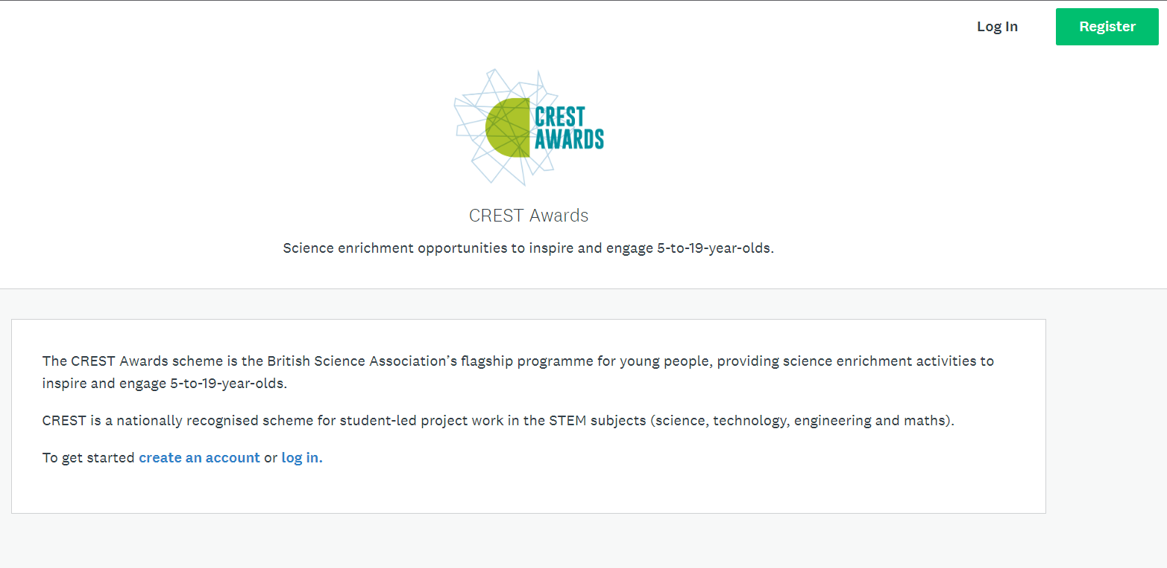
CREST AWARDS
HOW TO LOG A CREST AWARD

Slide 8
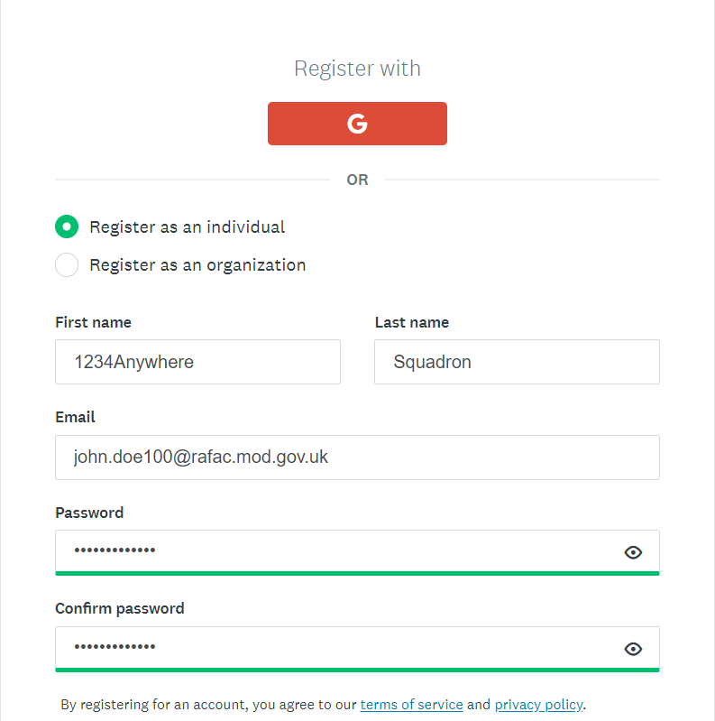
CREST AWARDS
HOW TO LOG A CREST AWARD

Slide 9
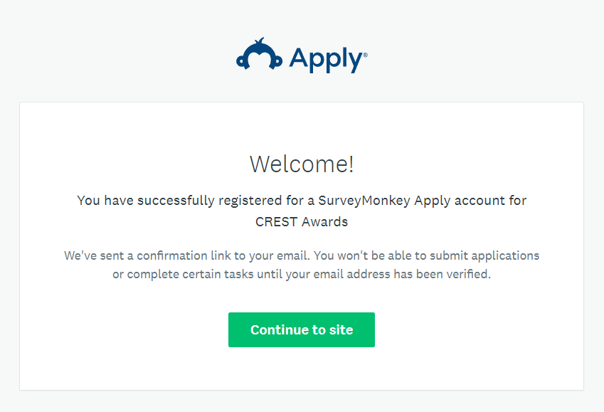
CREST AWARDS
HOW TO LOG A CREST AWARD

Slide 10
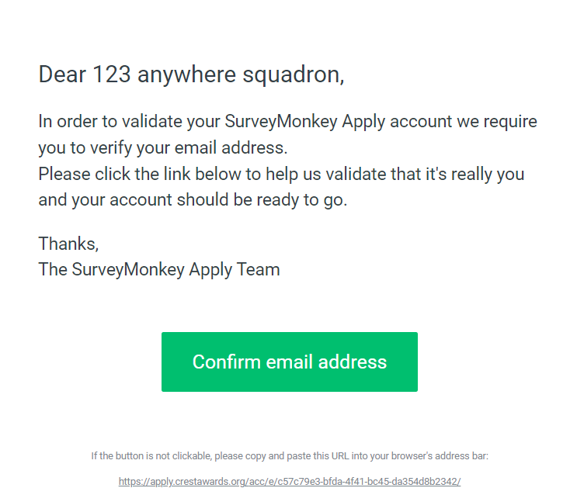
CREST AWARDS
HOW TO LOG A CREST AWARD

Slide 11
CREST AWARDS
HOW TO LOG A CREST AWARD

Slide 12
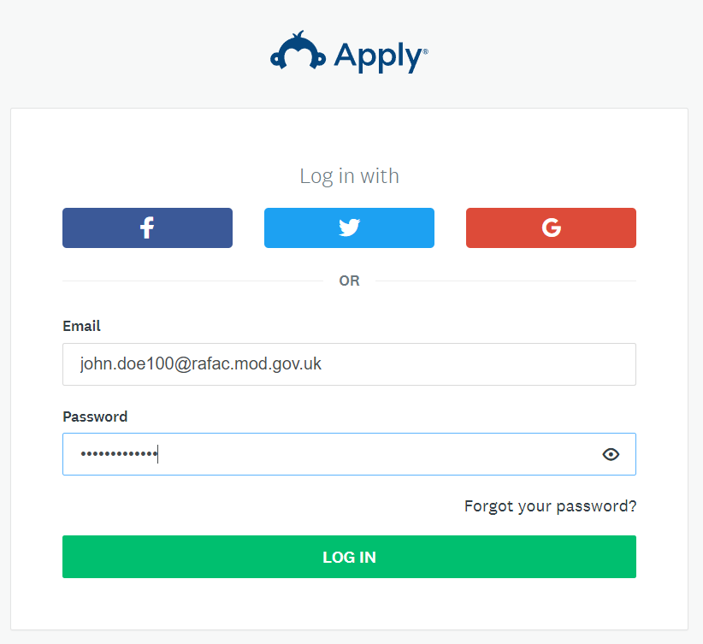
CREST AWARDS
HOW TO LOG A CREST AWARD

Slide 13
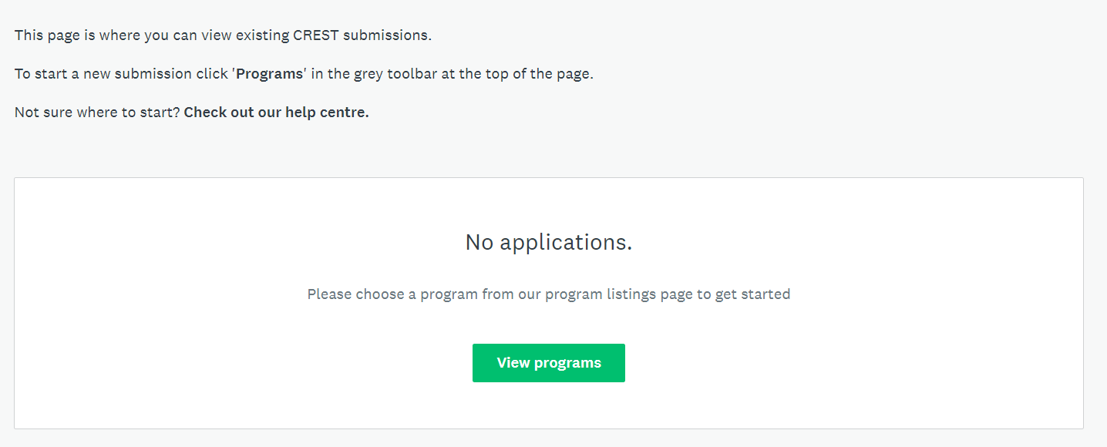
CREST AWARDS
HOW TO LOG A CREST AWARD

Slide 14
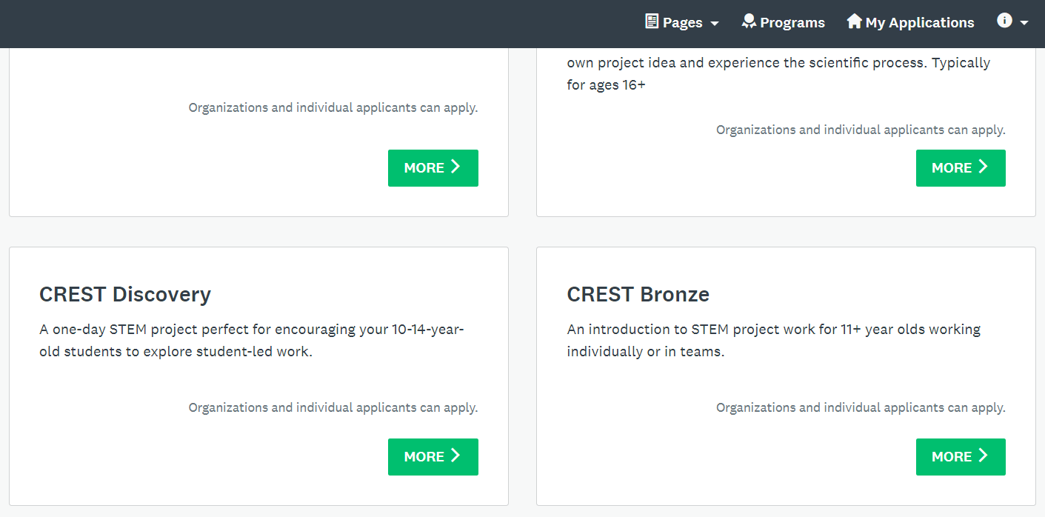
CREST AWARDS
HOW TO LOG A CREST AWARD

Slide 15
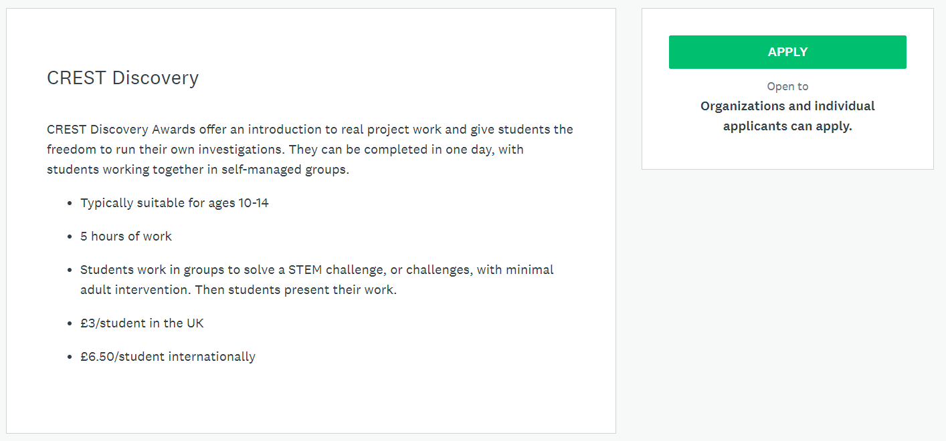
CREST AWARDS
HOW TO LOG A CREST AWARD

Slide 16
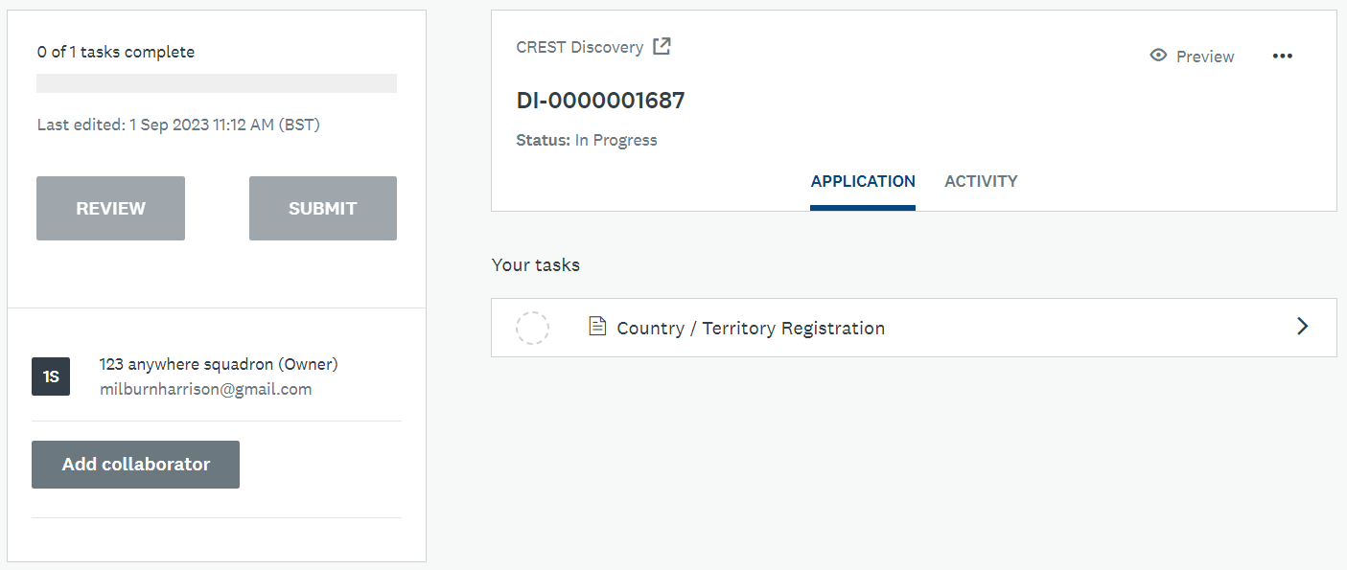
CREST AWARDS
HOW TO LOG A CREST AWARD

Slide 17
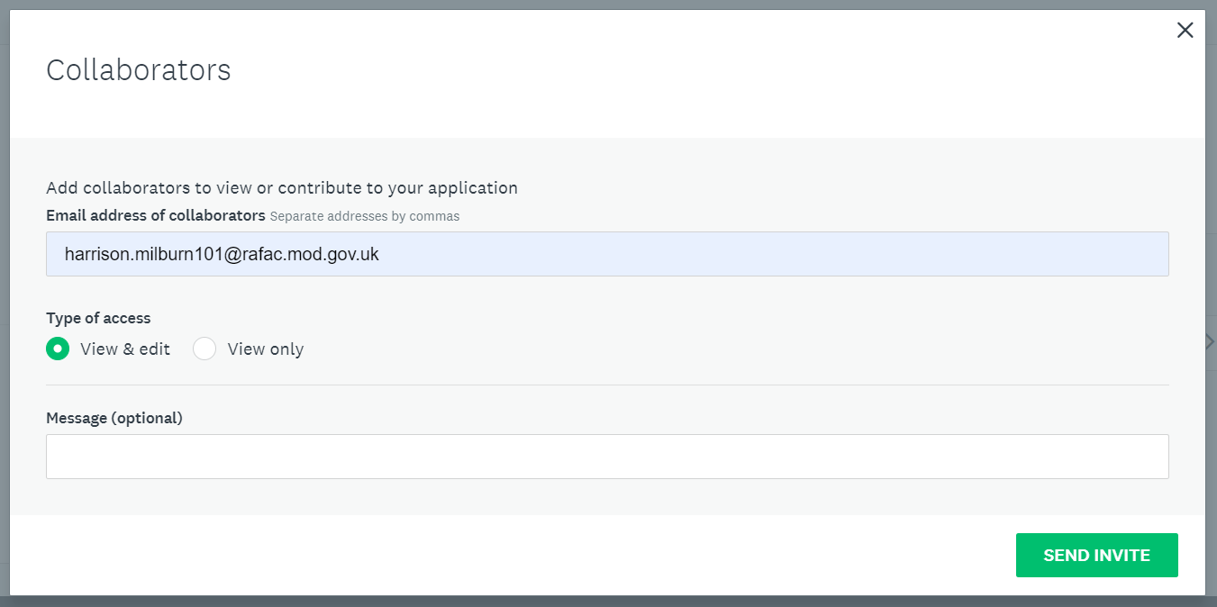
CREST AWARDS
HOW TO LOG A CREST AWARD

Slide 18
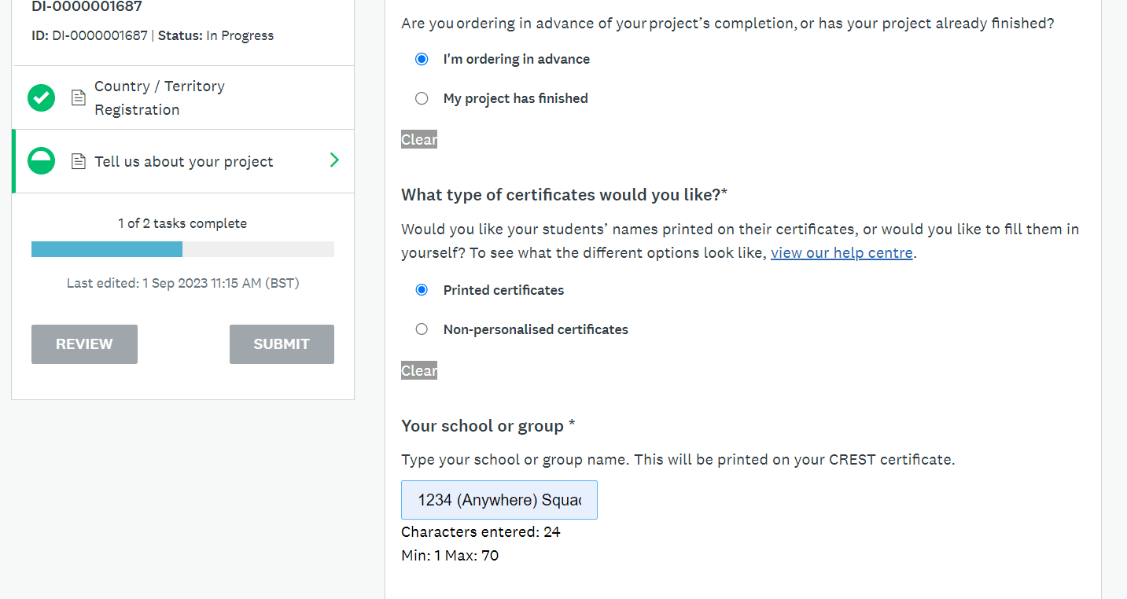
CREST AWARDS
HOW TO LOG A CREST AWARD

Slide 19
GOOD LUCK!
STEM

